Slide 1
INHERITANCE IN JAVA

Slide 2

7.Inheritence in Java
Sisoft Technologies Pvt Ltd
SRC E7, Shipra Riviera Bazar, Gyan Khand-3, Indirapuram, Ghaziabad
Website: www.sisoft.in Email:info@sisoft.in
Phone: +91-9999-283-283

Slide 3
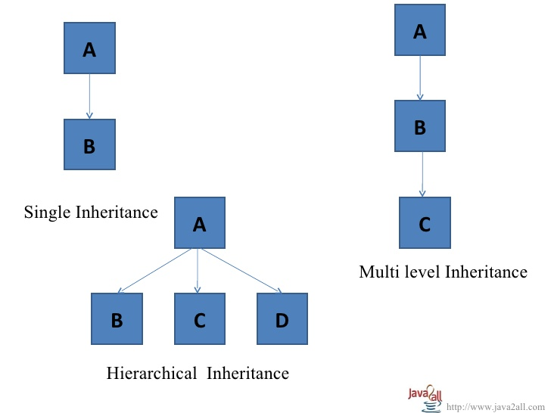
The derivation of one class from another class is called Inheritance.
Types of Inheritance in Java are:

Slide 4
A class that is inherited is called a super class.
The class that does the inheriting is called as subclass.
In above figure all class A is super class.
A subclass inherits all instance variables and methods from its super class and also has its own variables and methods.
One can inherit the class using keyword extends.
Syntax :
Class subclass-name extends super class-name
{
// body of class.
}

Slide 5
In java, a class has only one super class.
Java does not support Multiple Inheritance.
One can create a hierarchy of inheritance in which a subclass becomes a super class of another subclass.
However, no class can be a super class of itself.

Slide 6
class A //superclass
{
int num1; //member of superclass
int num2; //member of superclass
void setVal(int no1, int no2) //method of superclass
{
num1 = no1;
num2 = no2;
}
}
class B extends A //subclass B
{
int multi; //member of subclass
void mul() //method of subclass
{
multi = num1*num2; //accessing member of superclass from subclass
}
}
class inhe2
{
public static void main(String args[])
{
B subob = new B();
subob.setVal(5,6); //calling superclass method throgh subclass object
subob.mul(); System.out.println("Multiplication is " + subob.multi);
}}
Output :
Multiplication is 30

Slide 7
Note :
Private members of super class is not accessible in subclass,
super class is also called parent class or base class & subclass is also called child class or derived class.

Slide 8
Super & Final Keyword

Slide 9
super keyword :
super keyword is used to call a superclass constructor and to call or access super class members(instance variables or methods).
syntax of super : super (arg-list)
When a subclass calls super() it is calling the constructor of its immediate superclass.
super() must always be the first statement executed inside a subclass constructor.
super. member
Here member can be either method or an instance variables.)
This second form of super is most applicable to situation in which member names of a subclass hide member of superclass due to same name.

Slide 10
class A1
{
public int i;
A1()
{
i=5;
}
}
class B1 extends A1
{
int i;
B1(int a,int b)
{
super(); //calling super class constructor
//now we will change value of superclass variable i
super.i=a; //accessing superclass member from subclass
i=b;
}

Slide 11
void show()
{
System.out.println("i in superclass = " + super.i );
System.out.println("i in subclass = " + i );
}
}
public class Usesuper
{
public static void main(String[] args)
{
B1 b = new B1(10,12);
b.show();
}
}
Output :
i in superclass = 10
i in subclass = 12

Slide 12
Note:
The instance variable i in B1 hides the i in A, super allows access to the i defined in the superclass.
super can also be used to call methods that are hidden by a subclass.

Slide 13
Final keyword :
final keyword can be use with variables, methods and class.
=> final variables.
When we want to declare constant variable in java we use final keyword.
Syntax : final variable name = value;
=> final method
Syntax: final methodname(arg)
When we put final keyword before method than it becomes final method.

Slide 14
To prevent overriding of method final keyword is used, means final method cant be override.
=> final class
A class that can not be sub classed is called a final class.
This is archived in java using the keyword final as follow.
Syntax : final class class_name { ... }
Any attempt to inherit this class will cause an error and compiler will not allow it.

Slide 15
final class aa
{
final int a=10;
public final void ainc()
{
a++; // The final field aa.a cannot be assigned
}
}
class bb extends aa // The type bb cannot subclass the final class aa
{
public void ainc() //Cannot override the final method from aa
{
System.out.println("a = " + a);
}
}
public class Final_Demo
{
public static void main(String[] args)
{
bb b1 = new bb();
b1.ainc();
}
}
Here no output will be there because all the comments in above program are errors. Remove final keyword from class than you will get error like final method can not be override.

Slide 16
Method Overriding

Slide 17
Defining a method in the subclass that has the same name, same arguments and same return type as a method in the superclass and it hides the super class method is called method overriding.
Now when the method is called, the method defined in the subclass is invoked and executed instead of the one in the superclass.

Slide 18
class Xsuper
{
int y;
Xsuper(int y)
{
this.y=y;
}
void display()
{
System.out.println("super y = " +y);
}
}
class Xsub extends Xsuper
{
int z;
Xsub(int z , int y)
{
super(y);
this.z=z;
}

Slide 19
void display()
{
System.out.println("super y = " +y);
System.out.println("sub z = " +z);
}
}
public class TestOverride
{
public static void main(String[] args)
{
Xsub s1 = new Xsub(100,200);
s1.display();
}
}
Output :
super y = 200
sub z = 100
Here the method display() defined in the subclass is invoked.
Output :
super y = 200
sub z = 100

Slide 20
Method Overriding

Slide 21
Method Overriding

Slide 22
Defining a method in the subclass that has the same name, same arguments and same return type as a method in the superclass is called method overriding.
Now when the method is called, the method defined in the subclass is invoked and executed instead of the one in the superclass.

Slide 23
class Xsuper
{
int y;
Xsuper(int y)
{
this.y=y;
}
void display()
{
System.out.println("super y = " +y);
}
}
class Xsub extends Xsuper
{
int z;
Xsub(int z , int y)
{
super(y);
this.z=z;
}

Slide 24
void display()
{
System.out.println("super y = " +y);
System.out.println("sub z = " +z);
}
}
public class TestOverride {
public static void main(String[] args)
{
Xsub s1 = new Xsub(100,200);
s1.display();
}
}
Output :
super y = 200
sub z = 100
Here the method display() defined in the subclass is invoked.

Slide 25
Multilevel Inheritance

Slide 26
class student
{
int rollno;
String name;
student(int r, String n)
{
rollno = r;
name = n;
}
void dispdatas()
{
System.out.println("Rollno = " + rollno);
System.out.println("Name = " + name);
}}
class marks extends student
{
int total;
marks(int r, String n, int t)
{
super(r,n); //call super class (student) constructor
total = t;
}

Slide 27
void dispdatam()
{
dispdatas(); // call dispdatap of student class
System.out.println("Total = " + total);
}
}
class percentage extends marks
{
int per;
percentage(int r, String n, int t, int p)
{
super(r,n,t); //call super class(marks) constructor
per = p;
}
void dispdatap()
{
dispdatam(); // call dispdatap of marks class
System.out.println("Percentage = " + per);
}
}

Slide 28
class Multi_Inhe
{
public static void main(String args[])
{
percentage stu = new percentage(1912, "SAM", 350, 50); //call constructor percentage
stu.dispdatap(); // call dispdatap of percentage class
}
}
Output :
Rollno = 1912
Name = SAM
Total = 350
Percentage = 50

Slide 29
It is common that a class is derived from another derived class.
The class student serves as a base class for the derived class marks, which in turn serves as a base class for the derived class percentage.
The class marks is known as intermediated base class since it provides a link for the inheritance between student and percentage.
The chain is known as inheritance path.

Slide 30
When this type of situation occurs, each subclass inherits all of the features found in all of its super classes. In this case, percentage inherits all aspects of marks and student.
To understand the flow of program read all comments of program.
When a class hierarchy is created, in what order are the constructors for the classes that make up the hierarchy called?

Slide 31
class X
{
X()
{
System.out.println("Inside X's constructor.");
}
}
class Y extends X // Create a subclass by extending class A.
{
Y()
{
System.out.println("Inside Y's constructor.");
}
}
class Z extends Y // Create another subclass by extending B.
{
Z()
{
System.out.println("Inside Z's constructor.");
}
}

Slide 32
public class CallingCons
{
public static void main(String args[])
{
Z z = new Z();
}
}
The answer is that in a class hierarchy, constructors are called in order of derivation, from superclass to subclass.
Output:
Inside X's constructor.
Inside Y's constructor.
Inside Z's constructor.

Slide 33
Further, since super( ) must be the first statement executed in a subclass’ constructor, this order is the same whether or not super( ) is used.
If super( ) is not used, then the default or parameterless constructor of each superclass will be executed.
As you can see from the output the constructors are called in order of derivation.
If you think about it, it makes sense that constructors are executed in order of derivation.
Because a superclass has no knowledge of any subclass, any initialization it needs to perform is separate from and possibly prerequisite to any initialization performed by the subclass. Therefore, it must be executed first.

Slide 34
Dynamic Method Dispatch

Slide 35
Dynamic Method Dispatch:
Dynamic method dispatch is the mechanism by which a call to an overridden method is resolved at run time, rather than compile time.
Dynamic method dispatch is important because this is how Java implements run-time polymorphism.
A method to execution based upon the type of the object being referred to at the time the call occurs. Thus, this determination is made at run time.

Slide 36
In other words, it is the type of the object being referred to (not the type of the reference variable) that determines which version of an overridden method will be executed.

Slide 37
class A
{
void callme()
{
System.out.println("Inside A's callme method");
}
}
class B extends A
{
void callme() // override callme()
{
System.out.println("Inside B's callme method");
}
}
class C extends A
{
// override callme()
void callme()
{
System.out.println("Inside C's callme method");
}
}

Slide 38
public class Dynamic_disp
{
public static void main(String args[])
{
A a = new A(); // object of type A
B b = new B(); // object of type B
C c = new C(); // object of type C
A r; // obtain a reference of type A
r = a; // r refers to an A object
r.callme(); // calls A's version of callme
r = b; // r refers to a B object
r.callme(); // calls B's version of callme
r = c; // r refers to a C object
r.callme(); // calls C's version of callme
}
}
Output:
Inside A's callme method
Inside B's callme method
Inside C's callme method

Slide 39
Here reference of type A, called r, is declared.
The program then assigns a reference to each type of object to r and uses that reference to invoke callme( ).
As the output shows, the version of callme( ) executed is determined by the type of object being referred to at the time of the call.

Slide 40
Abstract Classes

Slide 41
When the keyword abstract appears in a class definition, it means that zero or more of it’s methods are abstract.
An abstract method has no body.
Some of the subclass has to override it and provide the implementation.
Objects cannot be created out of abstract class.
Abstract classes basically provide a guideline for the properties and methods of an object.

Slide 42
In order to use abstract classes, they have to be subclassed.
There are situations in which you want to define a superclass that declares the structure of a given abstraction without providing a complete implementation of every method.
That is, sometimes you want to create a superclass that only defines generalized form that will be shared by all of its subclasses, leaving it to each subclass to fill in the details.
One way this situation can occur is when a superclass is unable to create a meaningful implementation for a method

Slide 43
Syntax :
abstract type name(parameter-list);
As you can see, no method body is present. Any class that contains one or more abstract methods must also be declared abstract.
To declare a class abstract, you simply use the abstract keyword in front of the class keyword at the beginning of the class declaration.
There can be no objects of an abstract class. That is, an abstract class cannot be directly instantiated with the new operator.
Any subclass of an abstract class must either implement all of the abstract methods of the superclass, or be itself declared abstract.

Slide 44
abstract class A1
{
abstract void displayb1();
void displaya1()
{
System.out.println("This is a concrete method");
}
}
class B1 extends A1
{
void displayb1()
{
System.out.println("B1's implementation");
}
}
public class Abstract_Demo
{
public static void main(String args[])
{
B1 b = new B1();
b.displayb1();
b.displaya1();
}
}
Output:
B1's implementation
This is a concrete method

Slide 45
abstract class shape
{
double dim1;
double dim2;
shape(double a, double b)
{
dim1 = a;
dim2 = b;
}
abstract double area();
}
class rectangle extends shape
{
rectangle(double a, double b)
{
super(a,b);
}
double area()
{
System.out.println("Area of rectangle.");
return dim1*dim2;
}}

Slide 46
class triangle extends shape
{
triangle(double a, double b)
{
super(a,b);
}
double area()
{
System.out.println("Area of triangle.");
return dim1*dim2/2;
}
}
public class Abstract_D2
{
public static void main(String args[])
{
rectangle r = new rectangle(10,20);
triangle t = new triangle(10,6);
System.out.println(r.area());
System.out.println(t.area());
}}
Output:
Area of rectangle. 200.0
Area of triangle. 30.0

Slide 47
Object Classes

Slide 48
There is one special class, Object, defined by Java. All other classes are sub classes of Object.
That is, Object is a super class of all other classes.
This means that a reference variable of type Object can refer to an object of any other class.
Every class in java is descended from the java.lang.Object class.
If no inheritance is specified when a class is defined, the super class of the class is Object by default.

Slide 49
EX :
public class circle { ... }
is equivalent to
public class circle extends Object { ... }

Slide 50
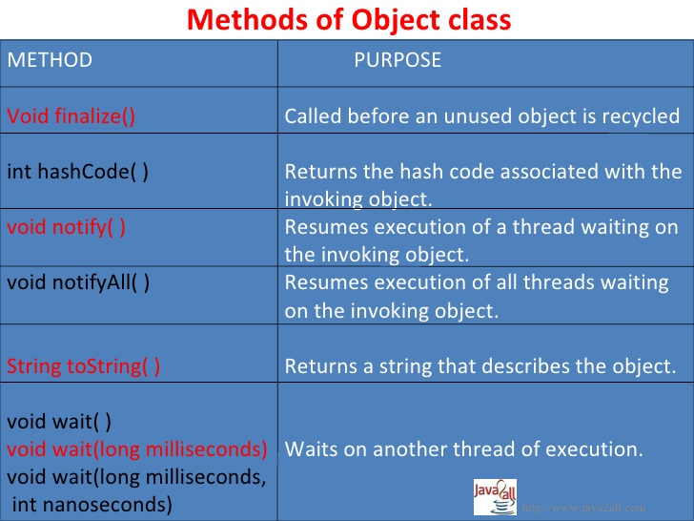

Slide 51
Methods of Object class:
The methods getclass(), notify(), notifyall() and wait() are declared as final.You may override the others.
tostring()
public String tostring()
it returns a String that describe an object.
It consisting class name, an at (@) sign and object memory address in hexadecimal.
EX :
Circle c1 = new Circle();
System.out.println(c1.tostring());
It will give O/P like Circle@15037e5
We can also write System.out.println(c1);

Slide 52
INTERFACE

Slide 53
Interface
The interface keyword takes the concept of abstractness one step further.
An interface is a group of related methods with empty bodies
An interface declaration can contain method signatures, default methods, static methods and constant definitions
The only methods that have implementations are default and static methods
In interfaces, no other of the methods are implemented means interfaces defines methods without body.
All abstract, default, and static methods in an interface are implicitly public, so you can omit the public modifier.
An interface can contain constant declarations.
All constant values defined in an interface are implicitly public, static, and final
Once again, you can omit these modifiers

Slide 54
Declaring interfaces in java with syntax
[Access-specifier] interface interface-name
{
return-type method-name(parameter-list);
type var1=value;
}
Where, Access-specifier is either public or it is not given.
When no access specifier is used, it results into default access specifier and if interface has default access specifier then it is only available to other members of the same package.
When it is declared as public, the interface can be used by any other code of other package.

Slide 55
Declaring interfaces in java with syntax
Interface-Name: name of an interface, it can be any valid identifier.
The methods which are declared having no bodies they end with a semicolon after the parameter list. Actually they are abstract methods
Variables can be declared inside interface declarations.
They are implicitly final and static, means they can not be changed by implementing it in a class.
They must also be initialized with a constant value.

Slide 56
Extending Inheritance
An interface can extend other interfaces
An interface can extend any number of interfaces
The interface declaration includes a comma-separated list of all the interfaces that it extends
Eg.
public interface Group1 extends Interface1, Interface2, Interface3

Slide 57
Interface vs Abstract Class
Interfaces are similar to abstract classes, but differ in their functionality.
Interfaces are syntactically similar to classes, but they lack instance variables, and their methods are declared without any body.

Slide 58
EX :
interface Item
{
static final int code = 100;
static final String name = "Fan";
void display ( );
}
interface Area
{
static final float pi = 3.14F;
float compute ( float x, float y );
void show ( );
}

Slide 59
Implementing Interfaces
Once an interface has been defined, one or more classes can implement that interface.
To implement an interface, include the implements clause in a class definition, and then create the methods declared by the interface.
The general form of a class that includes the implements clause looks like this:
Access-specifier class classname [extends superclass] [implements interface, [, interface..]]
{
// class body
}

Slide 60
Implementing Interfaces
If we are implementing an interface in a class we must implement all the methods defined in the interface as well as a class can also implement its own methods
But if a class implements an interface but does not fully implement the method defined by that interface, then that class must be declared as abstract.
Interfaces add most of the functionality that is required for many applications which would normally resort to using multiple inheritance in C++.

Slide 61
Implementing Interfaces
The methods that implement an interface must be declared as public.
The type-signature of implementing method must match exactly the type signature specified in the interface.
If a class implements from more than one interface, names are separated by comma.
If a class implements two interfaces that declare the same method, then the same method will be used by clients of either interface.

Slide 62
Ex:1
interface religion
{
String city = new String("Amritsar");
void greet();
void pray();
}
class gs implements religion
{
public void greet()
{
System.out.println("We greet - ABCD");
}
public void pray()
{
System.out.println("We pray at " + city + " XYZ ");
}
}

Slide 63
class iface1
{
public static void main(String args[])
{
gs sikh = new gs();
sikh.greet();
sikh.pray();
}
}
Output:
We greet - ABCD
We pray at Amritsar XYZ

Slide 64
Ex: 2
interface i1
{
void dispi1();
}
interface i2
{
void dispi2();
}
class c1 implements i1
{
public void dispi1()
{
System.out.println("This is display of i1");
}
}
class c2 implements i2
{
public void dispi2()
{
System.out.println("This is display of i2");
}}

Slide 65
class c3 implements i1, i2
{
public void dispi1()
{
System.out.println("This is display of i1");
}
public void dispi2()
{
System.out.println("This is display of i2");
}
}
class iface2
{
public static void main(String args[])
{
c1 c1obj = new c1();
c2 c2obj = new c2();
c3 c3obj = new c3();
c1obj.dispi1();
c2obj.dispi2();
c3obj.dispi1();
c3obj.dispi2();
}}
Output:
This is display of i1
This is display of i2
This is display of i1
This is display of i2

Slide 66
// Implementing interface having common function name
interface i1
{
void disp();
}
interface i2
{
void disp();
}
class c implements i1, i2
{
public void disp()
{
System.out.println("This is display .. ");
}}
class iface7
{
public static void main(String args[])
{
c cobj = new c();
cobj.disp();
}}
Output:
This is display ……
Note : When implementing an interface method, it must be declared as public. It is possible for classes that implement interfaces to define additional members of their own.

Slide 67
Partial Implementation of Interface :
If we want to implement an interface in a class we have to implement all the methods defined in the interface
But if a class implements an interface but does not fully implement the method defined by that interface, then that class must be declared as abstract.

Slide 68
interface i1
{
void disp1();
void disp2();
}
abstract class c1 implements i1
{
public void disp1()
{
System.out.println("This is display of 1");
}}
class c2 extends c1
{
public void disp2()
{
System.out.println("This is display of 2");
}}
class iface
{
public static void main(String args[])
{
c2 c2obj = new c2();
c2obj.disp1();
c2obj.disp2();
}}
Output:
This is display of 1
This is display of 2

Slide 69
Using an Interface as a Data Type
When you define a new interface, you are defining a new reference data type.
You can use interface names anywhere you can use any other data type name.
If you define a reference variable whose type is an interface, any object you assign to it must be an instance of a class that implements the interface.
When you call a method through one of these references, the correct version will be called based on the actual instance of the interface being referred to.

Slide 70
interface AreaCal
{
final double pi = 3.14;
double areacalculation(double r);
}
class Circle implements AreaCal
{
public double areacalculation(double r)
{
double ar;
ar = pi*r*r;
return ar;
}
}
class iface3
{
public static void main(String args[])
{
double area;
AreaCal ac = new Circle();
area = ac.areacalculation(10.25);
System.out.println("Area of Circle is : " + area);
}
}
Output:
Area of Circle is : 329.89625
Note : Here variable ac is declared to be of the interface type AreaCal,
it was assigned an instance of circle. Although ac can be used to access the areacalculation() method,
it cannot access any other members of the client class. An interface reference variable only has knowledge of the method declared by its interface declaration.

Slide 71
Extending interfaces :
One interface can inherit another by use of the keyword extends. The syntax is the same as for inheriting classes.
When a class implements an interface that inherits another interface,
It must provide implementation of all methods defined within the interface inheritance.
Note : Any class that implements an interface must implement all methods defined by that interface, including any that inherited from other interfaces.

Slide 72
interface if1
{
void dispi1();
}
interface if2 extends if1
{
void dispi2();
}
class cls1 implements if2
{
public void dispi1()
{
System.out.println("This is display of i1");
}
public void dispi2()
{
System.out.println("This is display of i2");
}}
public class Ext_iface
{
public static void main(String args[])
{
cls1 c1obj = new cls1();
c1obj.dispi1();
c1obj.dispi2(); }
}
Output:
This is display of i1
This is display of i2
Note : We have to define disp1() and disp2() in cls1.

Slide 73
Multiple inheritance using interface..
class stu
{
int rollno;
String name = new String();
int marks;
stu(int r, String n, int m)
{
rollno = r;
name = n;
marks = m;
}
}
interface i
{
void display();
}
class studerived extends stu implements i
{
studerived(int r, String n, int m)
{

Slide 74
super(r,n,m);
}
public void display()
{
System.out.println("Displaying student details .. ");
System.out.println("Rollno = " + rollno);
System.out.println("Name = " + name);
System.out.println("Marks = " + marks);
}
}
public class Multi_inhe_demo
{
public static void main(String args[])
{
studerived obj = new studerived(1912, "Ram", 75);
obj.display();
}
}
Output:
Displaying student details ..
Rollno = 1912
Name = Ram
Marks = 75

Slide 75
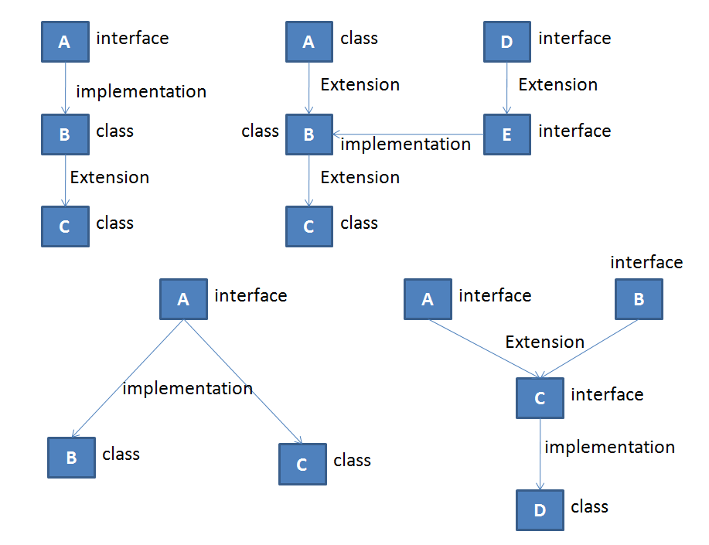
We can make various forms of interface implementation as below

